Slide 1
About this Class
Introduction to C# programming and software development.
Goal start making things in C#, without being an expert.
Not enough time to teach a lot
Providing lots of examples for you to play with
Designed especially for construction technology professionals
Recommended IDE is “Visual Studio 2022 Community”

Slide 2
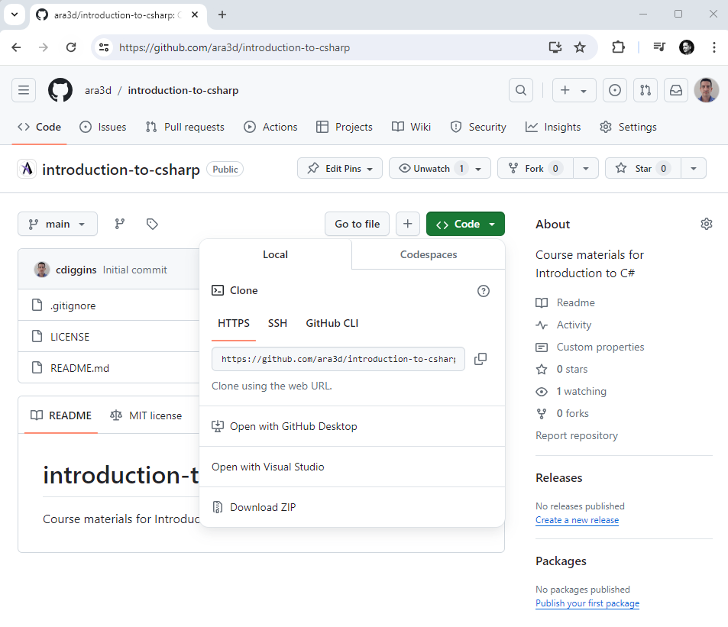
Course Material is Online

Slide 3
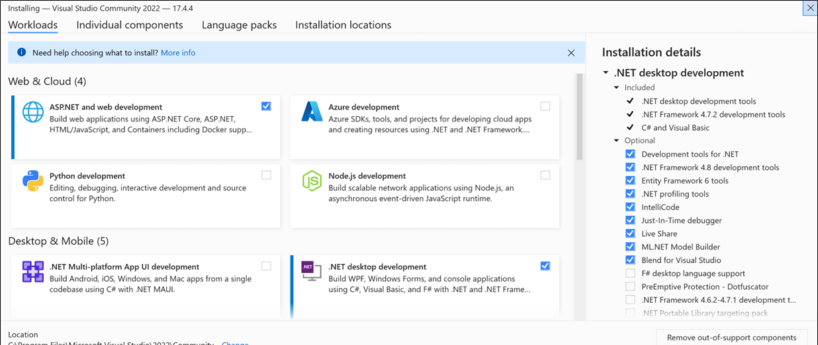
Visual Studio Community 2022
Only choose the .NET desktop development workload

Slide 4

About Me
My name is Christopher Diggins. I operate Ara 3D, a software development company.
Programming computers for 40 years. Some things I might take for granted, stop me if things aren’t clear
I enjoy programming, and I want you to enjoy it as well!

Slide 5
About You?
You are relatively new to programming
Maybe some Python experience
Programming is not your full-time job
You just want to learn quickly
You use Windows

Slide 6
Discuss
Introduce yourself
What is your programming background?
What would you like to learn in the next 3 hours?

Slide 7

Let’s Dive Right in

Slide 8
First Examples
Hello world
Writing to console
Main Entry point
Literal Constants
Hello who are you
Reading from console
String interpolation
Variables
Hello Command Line
Exceptions
Command Line Argument
Debugger

Slide 9
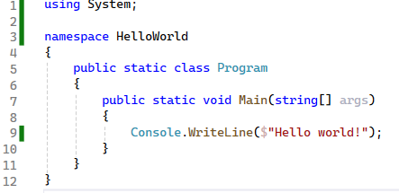

Slide 10
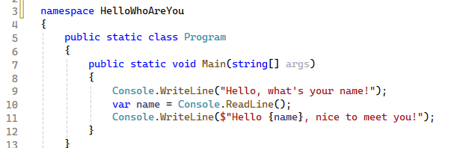

Slide 11
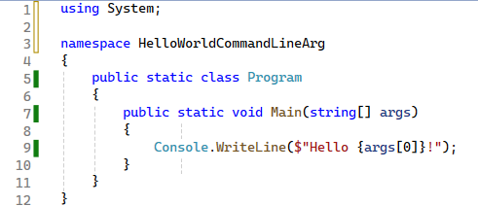

Slide 12
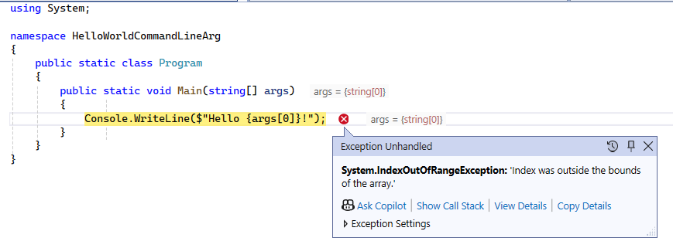

Slide 13
Passing Command Line Arguments
During testing you can put it in the “Debug Properties”
You can call it manually from command-line

Slide 14
Notes about Strings
They represent text in a computer program
Are collections of 16-bit characters
Can be indexed, they have a length
Are immutable: cannot be changed

Slide 15
Things to do to a string
Get number of characters
Get a character or substring
Construct a new one
Split it into an array of strings
Check if it contains, starts with, or ends with a sub-string
Convert to lower-case / upper-case
Replace characters
Change encoding
Read from or write to file
Notes:
These are all easily expressed in code, using Chat GPT.

Slide 16

What you can’t do to a string
Change it.

Slide 17

Null versus Empty String
A null string is one that has not been constructed
An empty string is constructed, but has zero length
Accessing methods on a null string will cause an error

Slide 18

Discussion
How many bits in a C# character?
If strings are “immutable” how do you modify them?

Slide 19
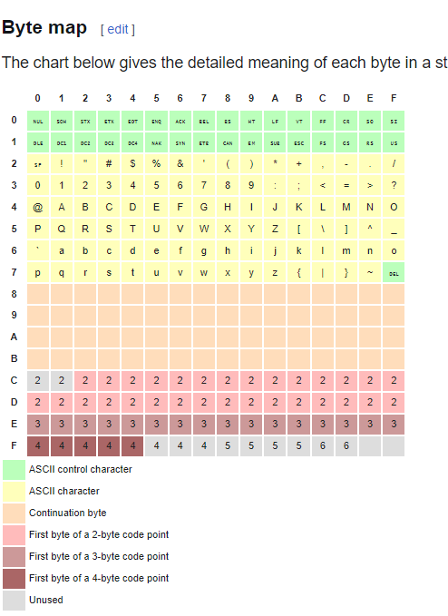
Notes on Encoding
Characters are just numbers
Those numbers map to glyphs based on encoding
Example encodings:
ASCII
EBCDIC
Utf8
Utf16
Latin1

Slide 20
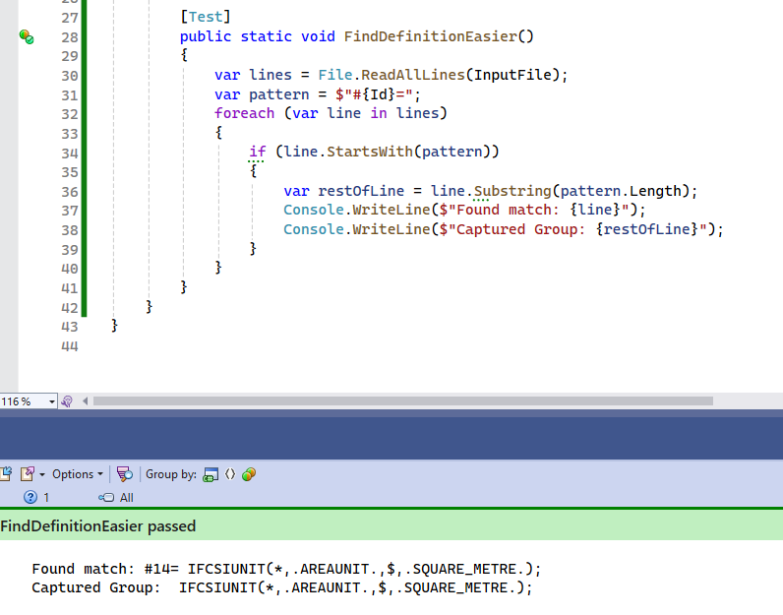
Pattern Matching

Slide 21
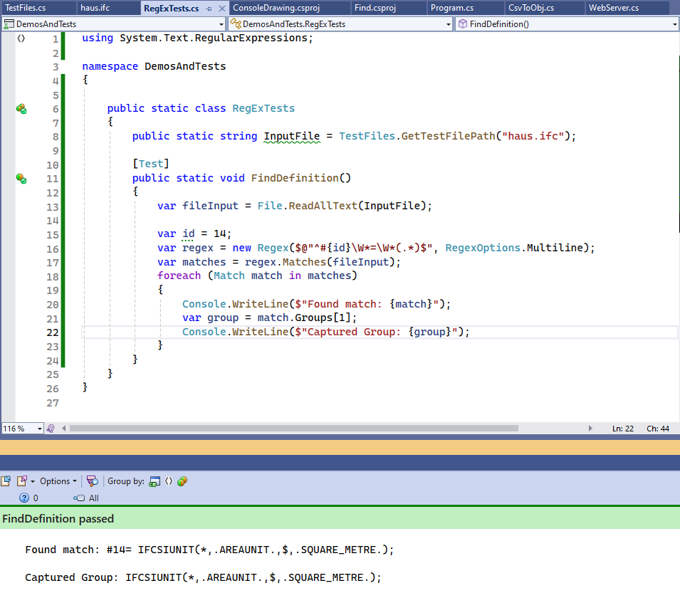
Using Regular Expressions

Slide 22
Understanding the Regular Expression String
$@"^#{id}\W*=\W*(.*)$"
$ = We are doing string interpolation
@ = Verbatim string `\` doesn’t require `\\` as usual in strings
^ = Matches beginning of string (or line)
{id} = Insert the string representation of the variable `id`
# = Part of the pattern we are searching for.
\W* = Matches zero or more whitespace character
( ) = Signifies a “capture group”
.* = Match as many characters as possible
$ = Matches end of string

Slide 23
When to use Regular Expressions?
For complex patterns and conditional logic
Never required, just sometimes convenient
Downside is, can be hard to understand and validate

Slide 24

About C#

Slide 25
C# Characteristics
An object-oriented language
Virtually everything is an object (or can be cast to an object)
A garbage collected language
Memory is automatically released when no-longer used
A strongly typed language
Every run-time value has a fixed type
A statically typed language
Every expression and variable has compile-time known type
A reflective language
Can query data types at run-time and use fields & methods
Compiles to byte-code
.NET assemblies contain IL byte-code

Slide 26
What is the point of static typing?
Provides a guarantee of safety during compilation
Helps the compiler produce efficient code
Make a program more predictable

Slide 27

Why C#?
Good tooling
Excellent standard library
Lots of 3rd party libraries
Easy to deploy
Cross-platform
Good performance
Stable
Good interoperability
Convenient syntax

Slide 28
Why not C#?
There is a lot of syntax and some outdated features
Sometimes we need hacks to get good performance
Not a great user experience when run in the browser
Have to restart application sometimes

Slide 29
Which Editing Environment?
Microsoft Visual Studio
Microsoft Visual Code
JetBrains Rider

Slide 30
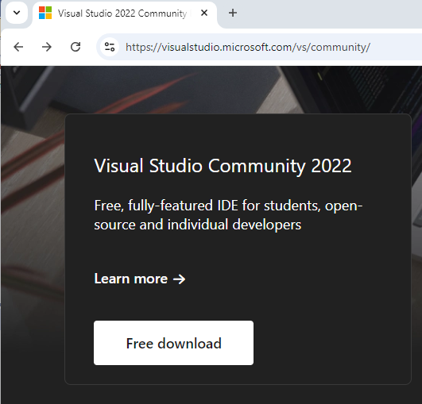
Visual Studio Community 2022
My recommended editor
Free, lots of tools, stable
Downside: Windows only

Slide 31

C# Project Types we will Cover Today
Console applications
WinForms GUI application (for Windows)
WPF application (for Windows)
Libraries
Unit tests
Unity Scripts [Time permitting]

Slide 32
The Secret Life of Console Applications

Slide 33

About Console Applications
A console application (by default) has no GUI
Aka “Command Line Interface” or CLI program
Can be executed with or without a console
Usually reads from standard input stream
Writes to standard output and error streams
Has command line arguments

Slide 34
Example Console Applications
Find
Sort
More
Type
Dir
Echo
Git

Slide 35

Common Command-Line Programming Tasks
Read or Write to a File or Stream
Respond to network requests
Perform a Computation
Launch a Process
Examine/set environment variables
Parse command-line arguments

Slide 36
Why learn about Console Applications
Putting small programs together can be useful
Helps with debugging and testing
Provides different ways of thinking about applications
In .NET every executable, can also be a library

Slide 37
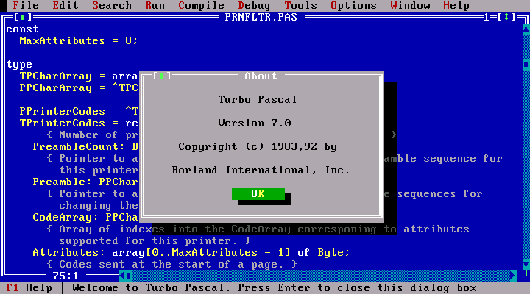
Technically – Can still Draw
Terminal emulators, such as cmd.exe, interpret special characters generated from standard stream as instructions for displaying output
See the “ConsoleDrawing.exe” Demo

Slide 38

Discuss
How can we communicate with a command-line application

Slide 39
Console Application Inputs
Standard Input
Pipes
Sockets
Environment Variables
Command Line Arguments
Files

Slide 40
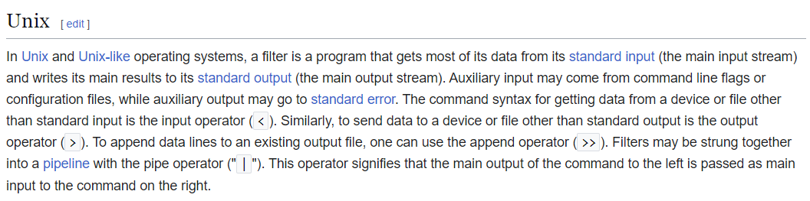

Slide 41
The Unix Philosophy (1978)
Do One thing Well
Make each program do one thing well. Build afresh rather than complicate old programs by adding new "features".
Program Output is other Program Input
Expect the output of every program to become the input to another unknown program.
Try Code Often and Early
Design and build software, to be tried early. Don't hesitate to throw away the clumsy parts and rebuild them.
Notes:
An operating system is one of the most complex software systems that you can develop.
This is the guide book for making Unix.

Slide 42
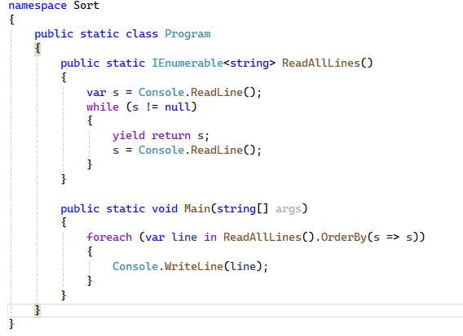
Sort Example
Reads lines until end of input
Input can be read from
Console
File
Another program

Slide 43
Examples
Dir
Dir /b
Dir > test.txt
Find “IFC”

Slide 44
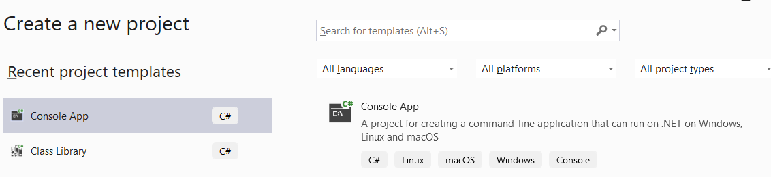
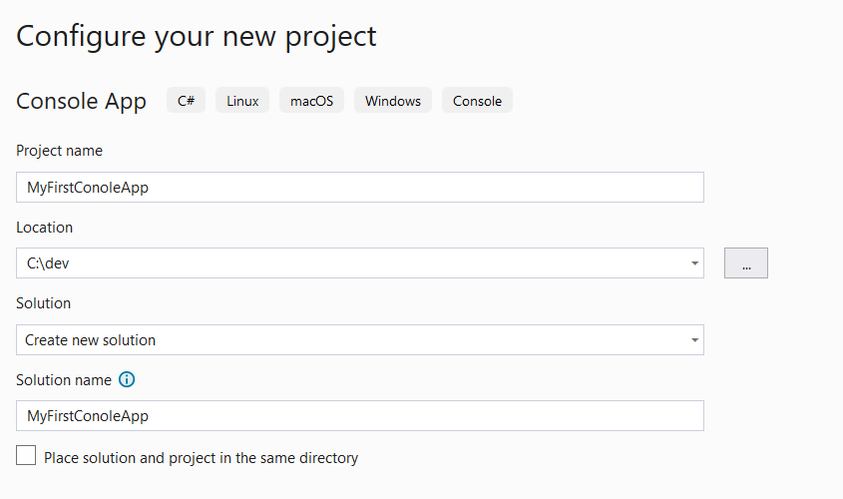
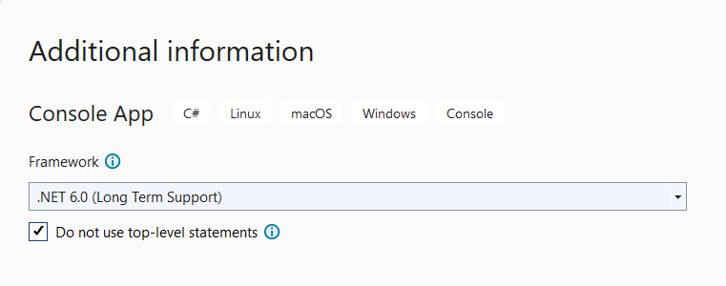
Let’s Make a Console Application
2
1
3

Slide 45
Last Seven Years of .NET / C#
C# Version | Date | .NET Framework | .NET / .NET Core | .NET Standard | Unity
7.0 | March 2017 | 4.7 | .NET Core 1.1 | 2.0
7.3 | May 2018 | 4.8 | .NET Core 2.2 | 2.0 | 2018.3
8.0 | September 2019 |  | .NET Core 3.1 | 2.1 | 2020.2 (partial)
9.0 | November 2020 |  | .NET 5.0 |  | 2021.2 (partial)
10.0 | November 2021 |  | .NET 6.0
11.0 | November 2022 |  | .NET 7.0
12.0 | November 2023 |  | .NET 8.0
Notes:
What Version to use? - When in doubt, use C# 7.3 and compile libraries with .NET Standard 2.0. Works with the widest range of tools and environments. Especially when you want to do plug-in development and support older Windows tools, or versions of Unity.

Slide 46
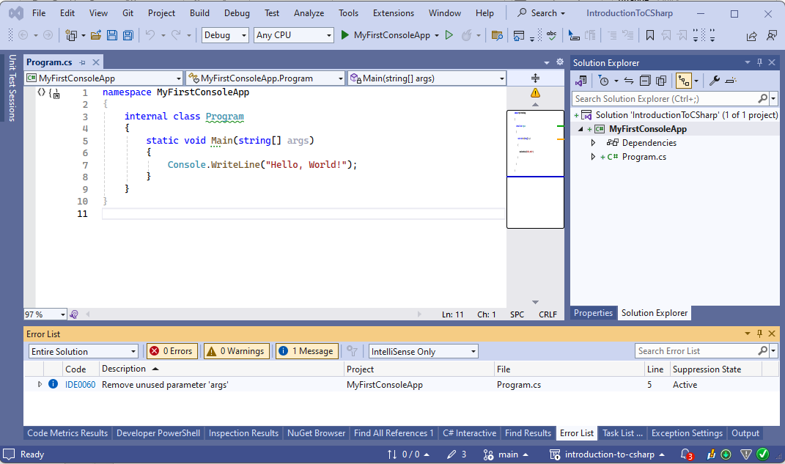
What you will see …

Slide 47
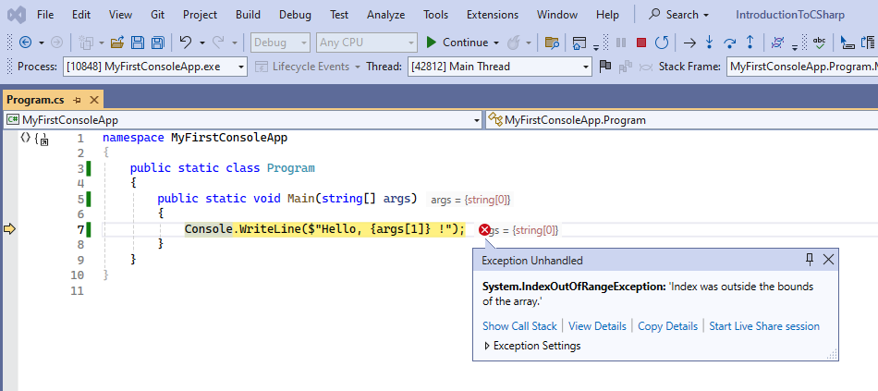
My First Error

Slide 48
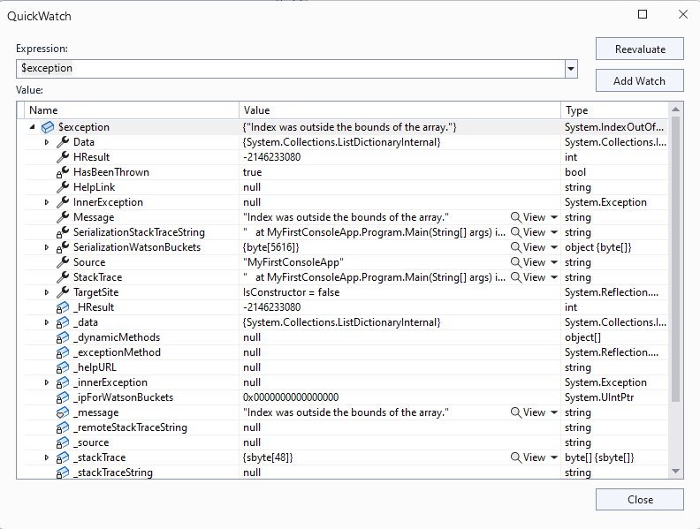

Showing Details shows us Much Details

Slide 49
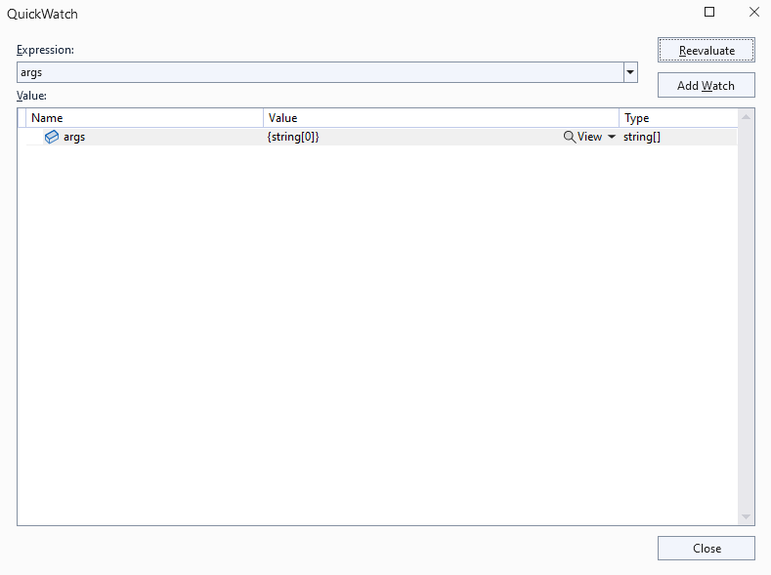
Changing the Expression gives us more clues

Slide 50
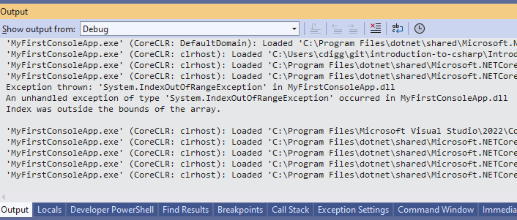
Okay I get the point

Slide 51
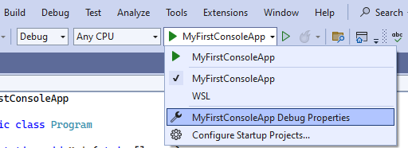
But why? The answer lies in debug properties

Slide 52
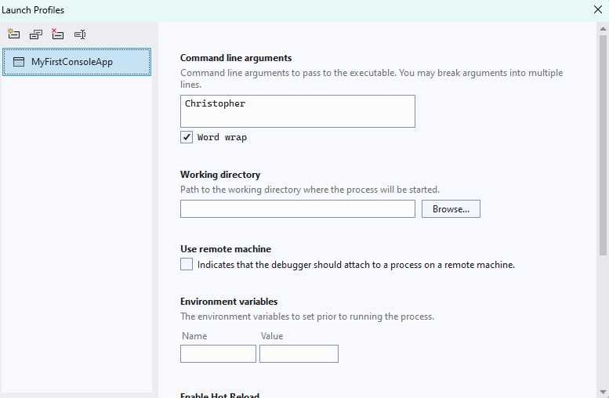
We can specify command line arguments, working directory and environment variables.

Slide 53
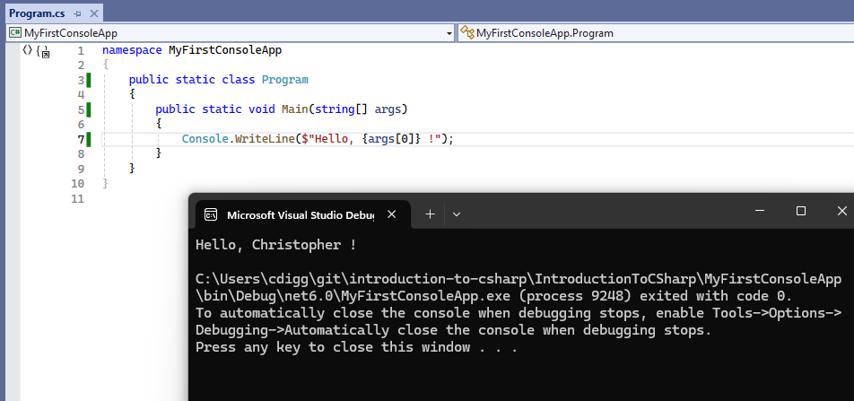
Woohoo, some success!

Slide 54
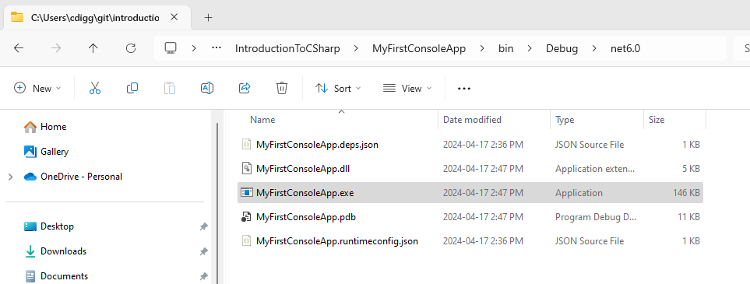
The generated files

Slide 55
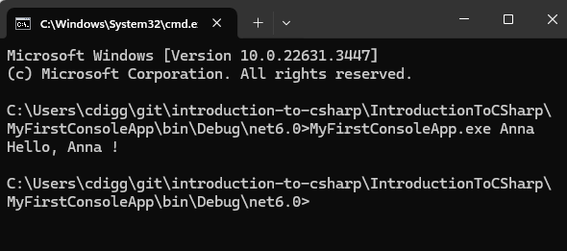
Which we can run from “cmd.exe” (aka the command line)

Slide 56

Standard I/O Streams
A very useful thing to learn about on
Relevant from any language and OS
Can be used with shell scripts (DOS batch)
There are three: std in, std out, and std err
Used by OS to redirect input/output between files and processes
Look like and are interchangeable with files

Slide 57

C# Launching a Process and Redirection
Launching a process
Redirect standard-input of process
Redirect standard-output of process
Redirect standard-output of current program

Slide 58
C# Streams
A stream is a read-only or write-only sequence of data
Usually, characters or bytes
StreamWriter writes characters to a stream
StreamReader reads characters to a stream
Console.WriteLine() writes to standard output
Console.ReadLine() reads from standard input
Streams are opened or closed
Usually unidirectional (can’t back up unless buffered)

Slide 59
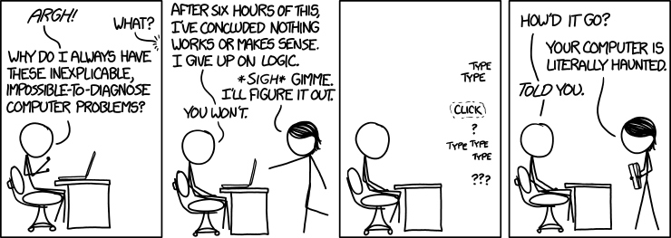
Debugging (and a bit of testing)
https://xkcd.com/1316/
By Randall Munroe

Slide 60

My view on Bugs … 🐛
There are no bugs
Just confused programmers …
Computers do exactly what they are told.

Slide 61

Debugging
Don’t delay learning debugging tools
It speeds up development and learning.
C# makes it very easy
This is my reason for preferring C#

Slide 62
Breakpoints and Pausing Debugger
A marker assigned to a statement that triggers debugger to pause.
Exceptions also can trigger debugger pauses
Programmatically you can use:
Debugger.Break() to pause
Debugger.Launch() to launch and attach debugger

Slide 63
Stepping Through Code
When debugger is paused you can step through code
Resume execution
Pause execution
Stop debugging (usually stops program)
Restart execution from beginning
Step over any function calls
Step into any function calls
Step out of current calls

Slide 64
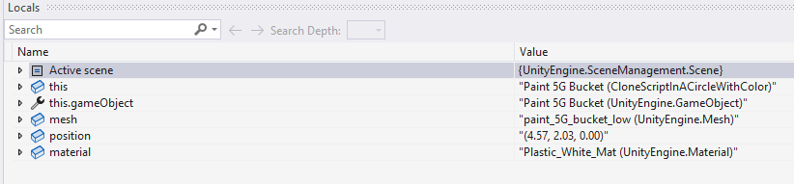
Watches
A window that shows the value associated with an expression.
We can view all local variables or specific expressions.
For more information on using watches see this article.

Slide 65
Tests Projects! 👩‍🔬
Tests are a powerful debugging tool
Check functions do what you think they should
Can be used to do exploratory coding
Useful for one-off tools, without creating a project

Slide 66
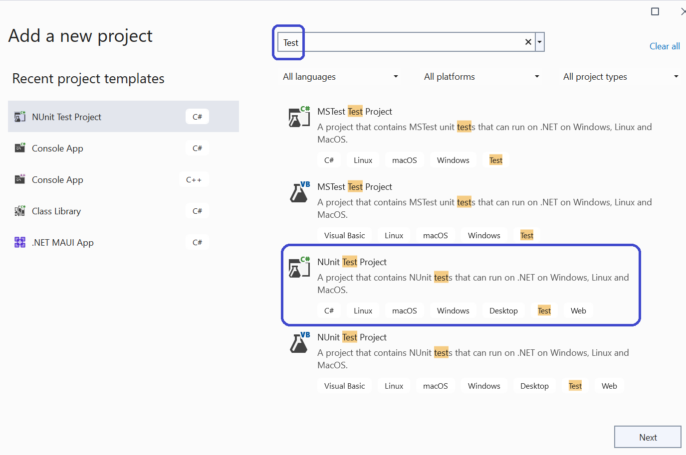
Test Projects: A special kind of library

Slide 67
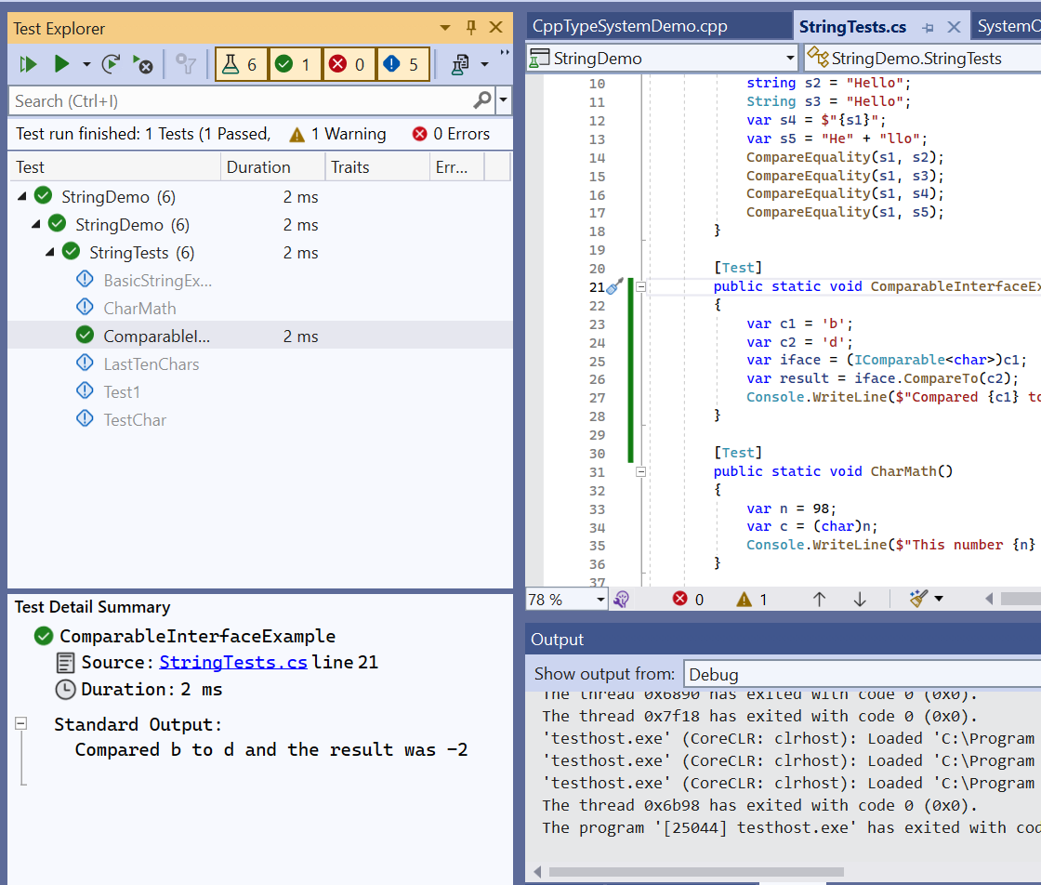
The Test Explorer Window

Slide 68
How to run the tests
Right click …

Slide 69
Using Tests as Tools
Mark the test as “explicit”
Example of launching a process.
Some tips and tricks:
Getting the “caller” folder
Using a set of files as inputs

Slide 70
Advice
Don’t be afraid to throw away tests
Start with tests

Slide 71
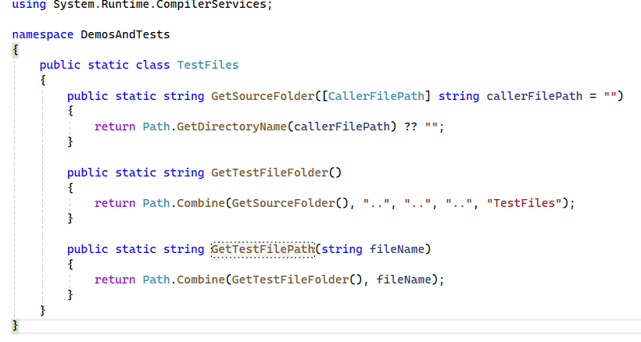
Get the Folder of Source

Slide 72
Launching Processes
Notepad
Web-browser
3D Geometry File

Slide 73
HTTP Server
Callbacks / Delegates
Threads (Multiple Lines of Execution)
Cancellation token
IDisposable
Streams and StreamWriter

Slide 74
Fun Stuff
You can draw colored shapes in the console.
See the Console.Drawing example

Slide 76
Collections
A collection is a value that contains other values.
A collection has items of the same type.
Examples include string, arrays, stacks, set, dictionaries, and lists.
We can get far with just using lists and dictionaries
Collections can be enumerated (support foreach)
Notes:
I used the word “collection” earlier.

Slide 77
Indexing
Lists, Arrays, and Strings use an integer index for each item
Indices start at 0
You can retrieve an item: myList[index]
You can (sometimes) modify an item at a position: myList[index] = 12
The last item in a list is: myList[myList.Count – 1]

Slide 78

Arrays
The grandfather of collections
Most languages have built-in arrays
Supports fast indexing
Fast length queries
Can’t insert things
Can’t remove things
Length is fixed upon construction

Slide 79
IEnumerable<T>
An IEnumerable<T> is a generalization of collections
Enumerating means visiting each item in order one by one
Allows you to use ForEach loops on a data type.

Slide 80
Important
All collections support IEnumerable
IEnumerable is a stream abstract data type
It has very limited capability

Slide 81
What is a Stream
A sequence of data made available over time
Represents a data source or data sink
The next value might not be ready for a while
Streams are potentially infinite (codata)

Slide 82

Class Libraries
Class libraries are a secret weapon
Putting code in a library simplifies problems
Provides opportunity to reuse solutions
Saves time and reduces complexity

Slide 83

.NET Assemblies
Class libraries are also called “assemblies”
They have a .DLL extension
They consist of IL byte-code
They can be inspected programmatically
They can be easily loaded dynamically
They can be easily decompiled
BTW .NET exe files are also assemblies!

Slide 84
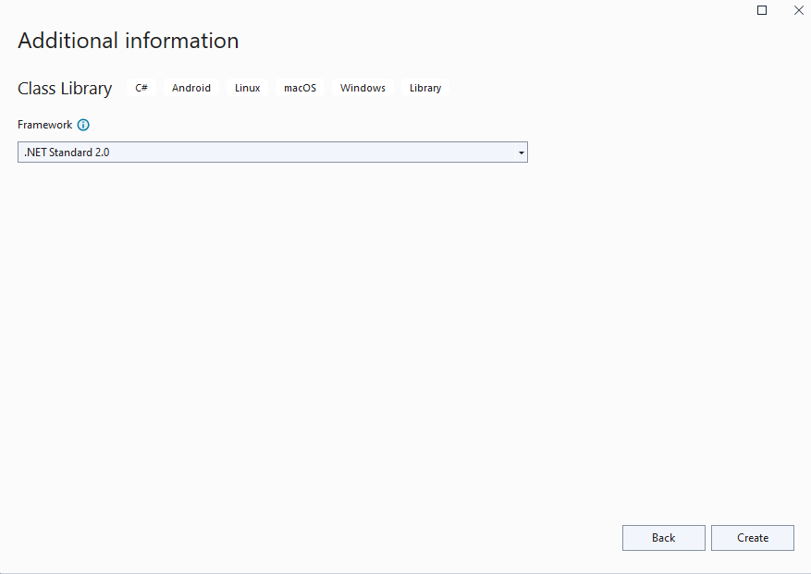
Use .NET Standard 2.0 for Compatibility

Slide 85
About .NET Standard 2.0
Compatible with .NET 4.7, .NET Core 2.1, and Unity 2018.3
Compatible with C# 7.3
But, only for libraries not executables or tests
Great for cross platform compatible code
Important for plug-ins to run on older versions of tools

Slide 86
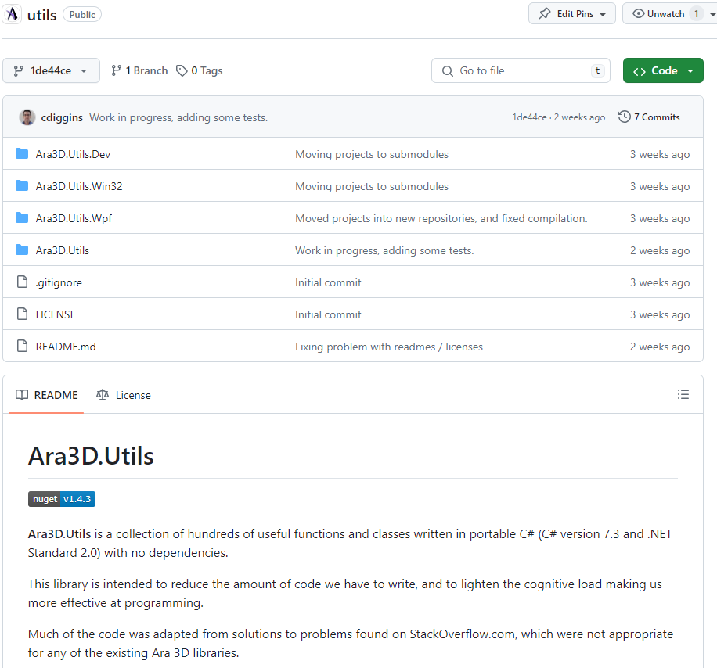
Ara3D.Utils
I have a ton of libraries
They make my life easier.
They are my “Batman utility belt”

Slide 87

The Basics of a Graphical User Interface
A GUI executes within the context of a window manager.
A hidden loop dispatches windows messages to your code.

Slide 88
Choosing a C# GUI
WinForms is quickest to learn and start using.
For Windows only .
WPF is significantly more powerful and flexible
For Windows only
MAUI is a cross-platform mobile app UI framework
A successor to Xamarin
ASP.NET
For web-based UI
3rd party options:
Avalonia UI - https://avaloniaui.net/
Uno - https://platform.uno/

Slide 89
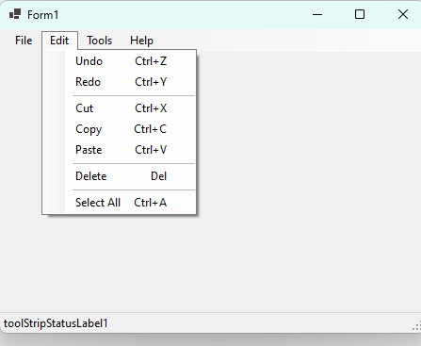
WinForms is from 1995 … but so what?

Slide 90
Using Events
Events are functions you write called in response to user input
Also called callback functions or delegates

Slide 91
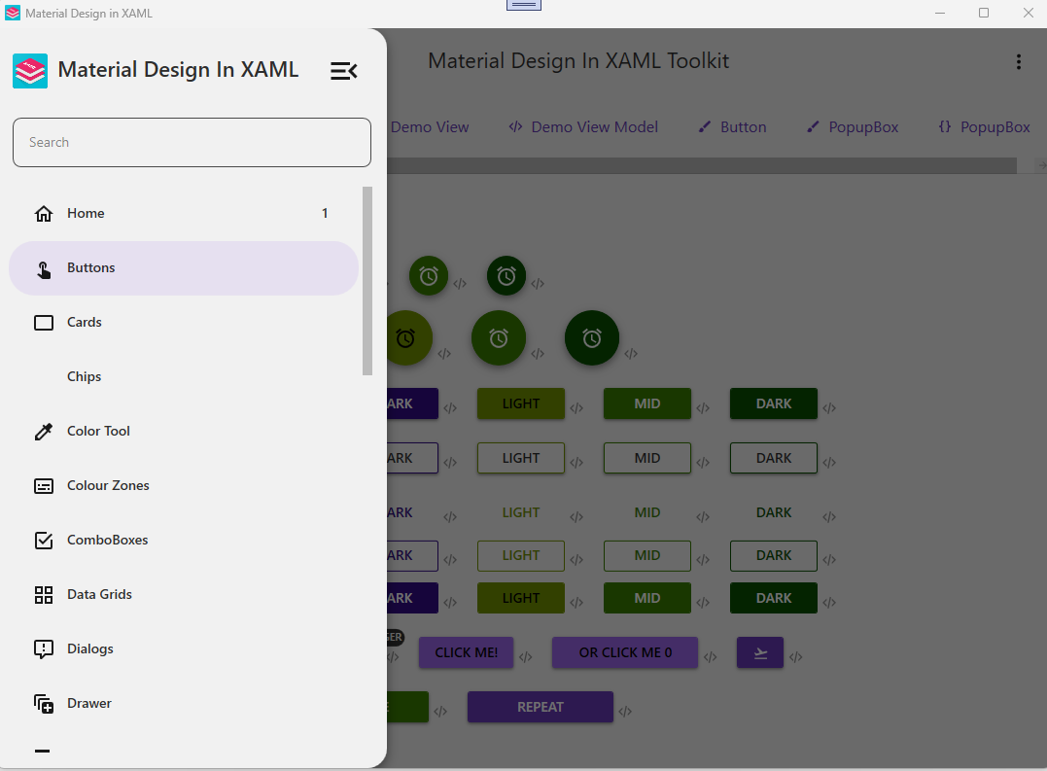
WPF is more modern (somewhat) and flexible

Slide 92
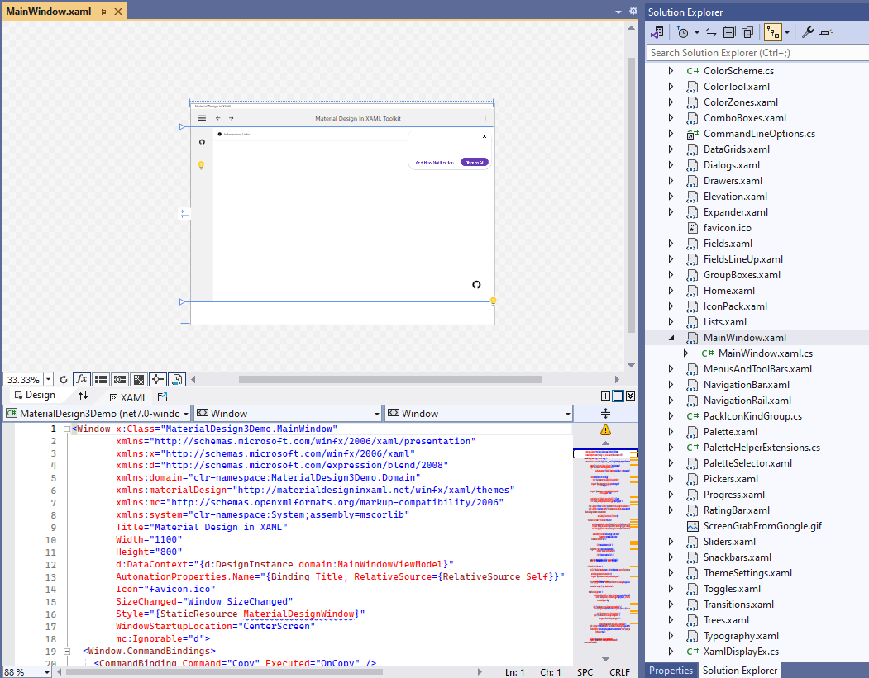
Windows Presentation Framework (WPF)
Uses XAML to express layout and basic UI concepts
Uses data-binding to decouple presentation from business logic
Also very old, but more modern than WinForms
Currently best option for Windows desktop UI

Slide 93
Data Binding
Based on a generic event
INotifyPropertyChanged
Has one event handler
Called by data model whenever data is changed
For example: via a property
UI controls listen to event and retrieves new values from properties
Uses reflection magic

Slide 94
XAML
An XML based declarative language
Specifies relationships and properties of graphical components
Maps to constructors and initializers in code behind
Has special embedded language for expressing bindings

Slide 95
Code Behind
This is the code that is generated from XAML files
Instead of using XAML we can use code-behind
It can beeasier for new programmers

Slide 96
Interop
How to call C++ (native code)
PInvoke

Slide 97
Linking to Libraries
DLL or EXE can be linked if they are managed assemblies
You can call into native libraries using PInvoke
Reference projects
Can use Nuget

Slide 98
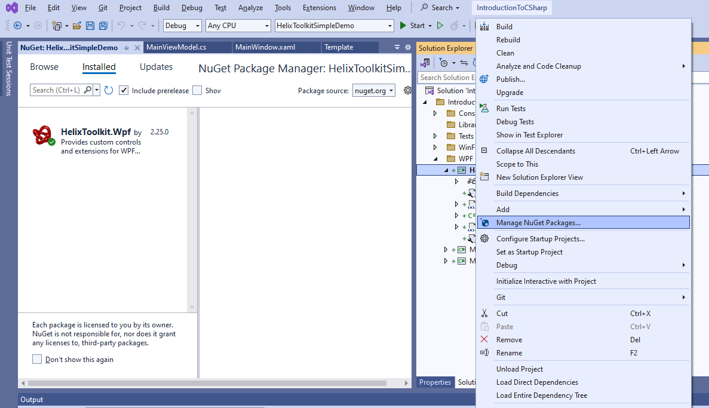
Nuget – C# Package Manager

Slide 99
Trouble Shooting Plug-ins
When writing plug-ins
A DLL with same name but different version might be already loaded
Some DLLs should not be copied
Libraries might not be found

Slide 100
Programmers are the root of all complexity
… that and mutable state.

Slide 101
Objectives
Understand how you can make coding easier
Or rther stop making it harder

Slide 102
Effective Programming
The secret to being an effective programmer is that we don’t have to remember the details, because we can create well crafted functions and data types that hide the details of how to do things, and instead describe what we want to achieve.
This is the hallmark of a style of programming called functional programming, and it results in code that is easier to understand and refactor.

Slide 103
The Unix Philosophy (1978)
Do One thing Well
Make each program do one thing well. Build afresh rather than complicate old programs by adding new "features".
Program Output is other Program Input
Expect the output of every program to become the input to another unknown program.
Try Code Often and Early
Design and build software, to be tried early. Don't hesitate to throw away the clumsy parts and rebuild them.
Notes:
An operating system is one of the most complex software systems that you can develop.
This is the guide book for making Unix.

Slide 104
Use many Small Functions
Easy to understand
More likely to be reusable

Slide 105
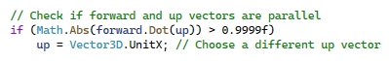
How could this be improved?

Slide 106
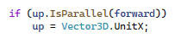
How about this?

Slide 107
More Data Structures
If you are passing around multiple parameters
Why not bundle them together?
Instead of:
Do this

Slide 108

May seems insignificant, but
Now you can have an implicit cast
A function can easily return it
Less documentation is required
Notes:
Little differences add up. When I code review for my colleagues, they think I’m obsessive.

Slide 109
Why is code reduction good?
Less possibility of mistakes
Fewer tests to write
Easier to understand and debug
Easier to maintain and modify

Slide 110
Continuous Refactoring
While writing code, ask yourself:
Is there a simpler way to do this?
Is there a function that would make this easier to read and write?
Am I repeating myself?
Are there too many parameters?
Is there a data structure that would make this easier to work with?

Slide 111
Programming Principles
Make it as easy to understand as possible
Code for People not Computers
Describe the Problem, not the Solution
What you think is obvious, is not to other people
Notes:
What you think is clear Is surprisingly confusing to other people.
Describe the Problem, not the Solution

Slide 112
Takeaways
Libraries and tests are secret weapons
Learning 20% of the language and tools can be sufficient
Practice, practice, practice

Slide 113
Some things I skipped
Defining new classes
Operator overloading
Reflection
Tuples
Lambdas
Interfaces
Virtual / Abstract

Slide 114
Stuff
String interpolation
Could use “string concatenation”
String splitting
Lists
IEnumerable

Slide 115
Collections versus IEnumerable

Slide 116
IEnumerable<T>
An IEnumerable<T> is a generalization of collections
Enumerating means visiting each item in order one by one
Allows you to use ForEach loops on a data type.

Slide 117
Important
All collections support IEnumerable
IEnumerable is a read-only stream ADT
It has limited capability

Slide 118
Basic IEnumerable<T> (LINQ) Methods
Select – Create new sequence by transforming each item into a new one using a function
Where - Filter a sequence by checking against a conditional function (predicate)
Aggregate - Combine elements of a sequence using a function (generalization of sum)
Zip – Combine elements between two sequence pairwise to create a new one.

Slide 119
What is a Stream
A sequence of data made available over time
Represents a data source or data sink
The next value might not be ready for a while
Streams are potentially infinite (codata)

Slide 120
Two Meanings of Stream
A file, socket, pipe, device
“File-like” things
In C it would be a FILE*
An enumerable sequence of data
Something you can enumerate with foreach

Slide 121
C# Scripts
Within Unity

Slide 122
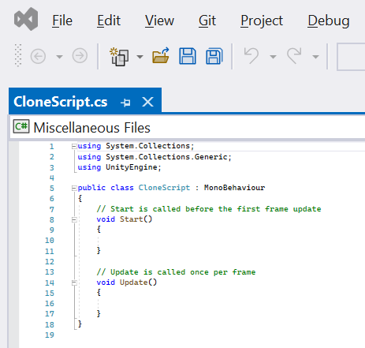
Class
A class describes a particular type of object.
What data it contains
What operations it has

Slide 123
Using Declarations
The using declaration says what library parts are used in the current file.
Extra functionality is provided by libraries.
Libraries are organized using namespaces.
For example: two things called “List” might exist in different libraries.
Namespaces disambiguate.

Slide 124
Inheritance
In Unity all scripts are classes that inherit from a Unity class called “MonoBehavior”.
This means that the things that a MonoBehavior can do, and the values that it contains, are accessible to the new class.
This is called inheritance and is a feature of object-oriented programming (OOP).

Slide 125
Comments
Comments are for humans and have no impact on programs.

Slide 126
Functions
Start function is called by Unity once when the game starts.
Update function is called by Unity every frame of the game.

Slide 127
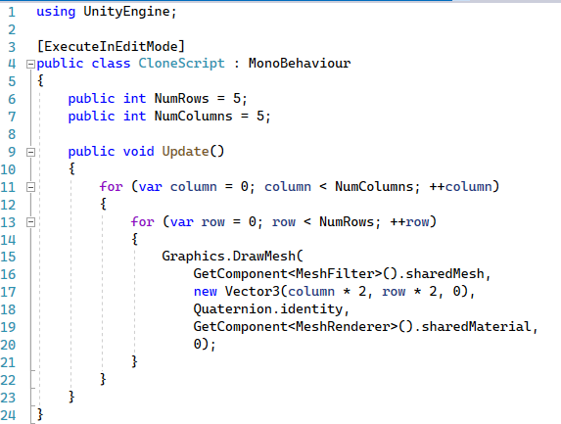
A Cloner Script in Unity

Slide 128
Attribute
Meta-information for the compiler or host environment.
Available through Reflection.
Tells the script to run in editor even when the game is not playing.

Slide 129
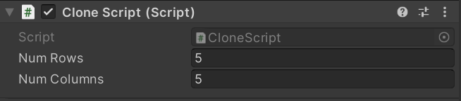
Fields
A field is named data associated with an object. Also known as a “member variable”.

Slide 130
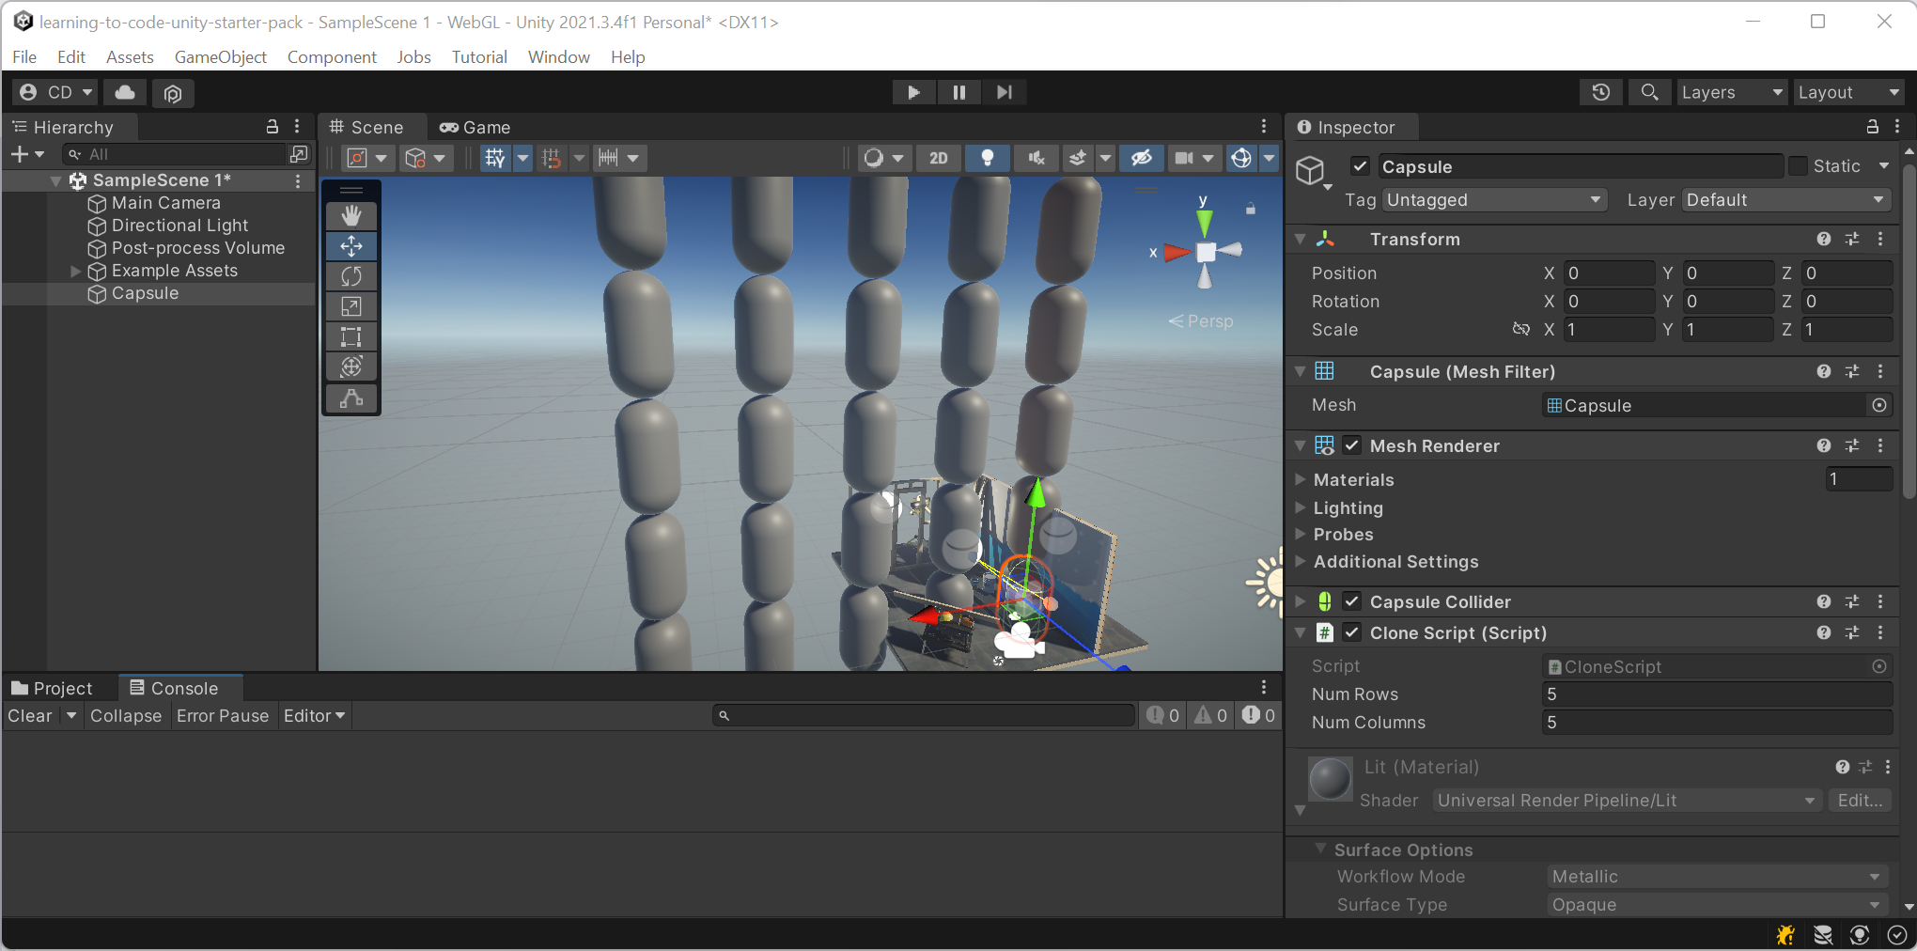

Slide 131
Unity is Great … but
It has its own way of doing things.
It has two separate math libraries (three if you count shader code)
It is designed for creating games
It has an expensive license
The library is only single-precision
Not designed for usage in CAE/CAD/BIM applications

